Slide 1
IoT Urban Farming for Net Zero Carbon Emission in SME Restaurants
Fred Luch Josh Alcantara

Slide 2
Introduction
According to research by Lloyds Bank, 91% of SMEs consider sustainability important, and 45% have increased their focus on sustainability due to the COVID-19 pandemic.
However, many small businesses struggle to understand and meet the demands of achieving Net Zero goals.
Introducing IoT-enabled urban farming using Raspberry Pi as a solution for small restaurants to support their journey towards Net Zero emissions.
This prototype consists of using the following technology:
- Flask(Python web framework), SQL, Raspberry Pi Pico W, Moisture Soil Sensor and BME280.

Slide 3
Why SME restaurants?
The conventional methods of supplying food result in high levels of carbon emissions due to transportation, refrigeration, and packing. It is essential to make significant changes in these aspects to achieve net zero carbon emissions.
Due to the pandemic, the cost of living has risen, resulting in financial strain for many individuals when it comes to accessing services and products. The prototype aims to assist small businesses in achieving both net-zero carbon emissions and financial stability by reducing their reliance on services and goods as they will be able to grow it from scratch.
Growing ingredients through urban farming:
Restaurants have the potential to reduce carbon emissions by limiting long-distance transportation.
By utilizing IoT sensors, resources can be used more efficiently, reducing waste and promoting sustainable practices.
Fresh produce available year-round reduces the need for seasonal and imported ingredients, lowering carbon emissions and promoting sustainability.
Real-time monitoring and data analytics enable optimized crop growth, increasing efficiency and reducing resource usage.
Finally, the business can build a good relationship with customers as they will know the goods served are freshly grown by the business.

Slide 4
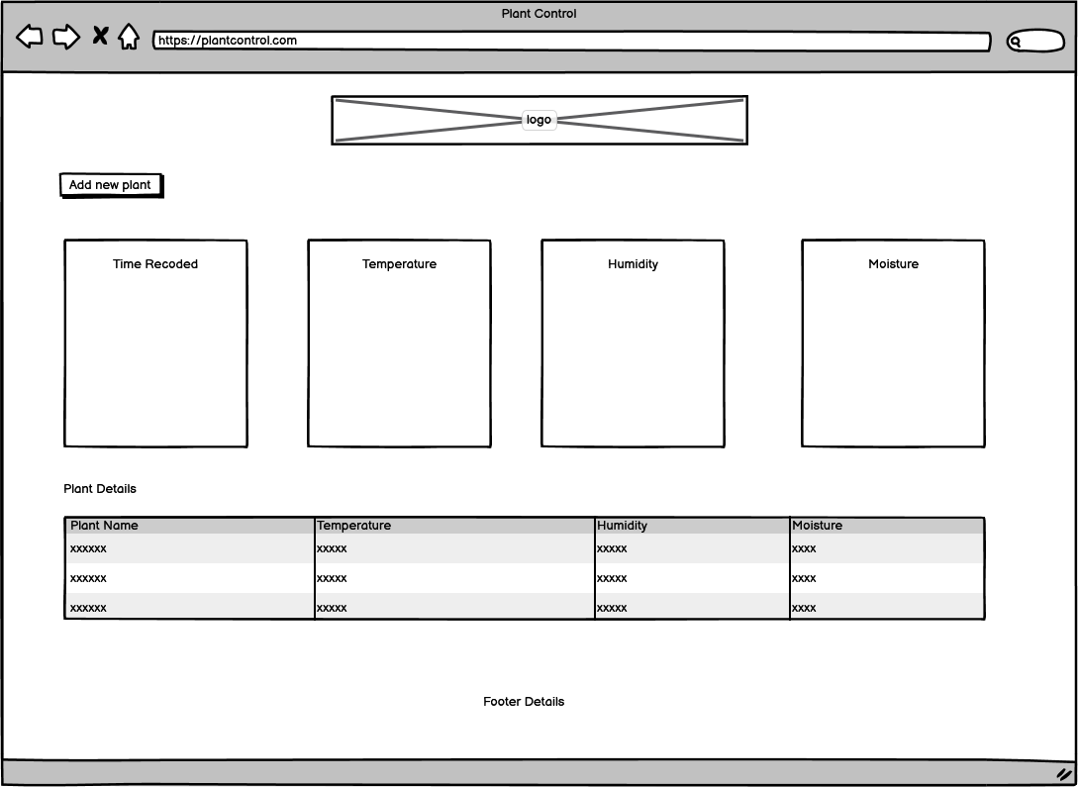
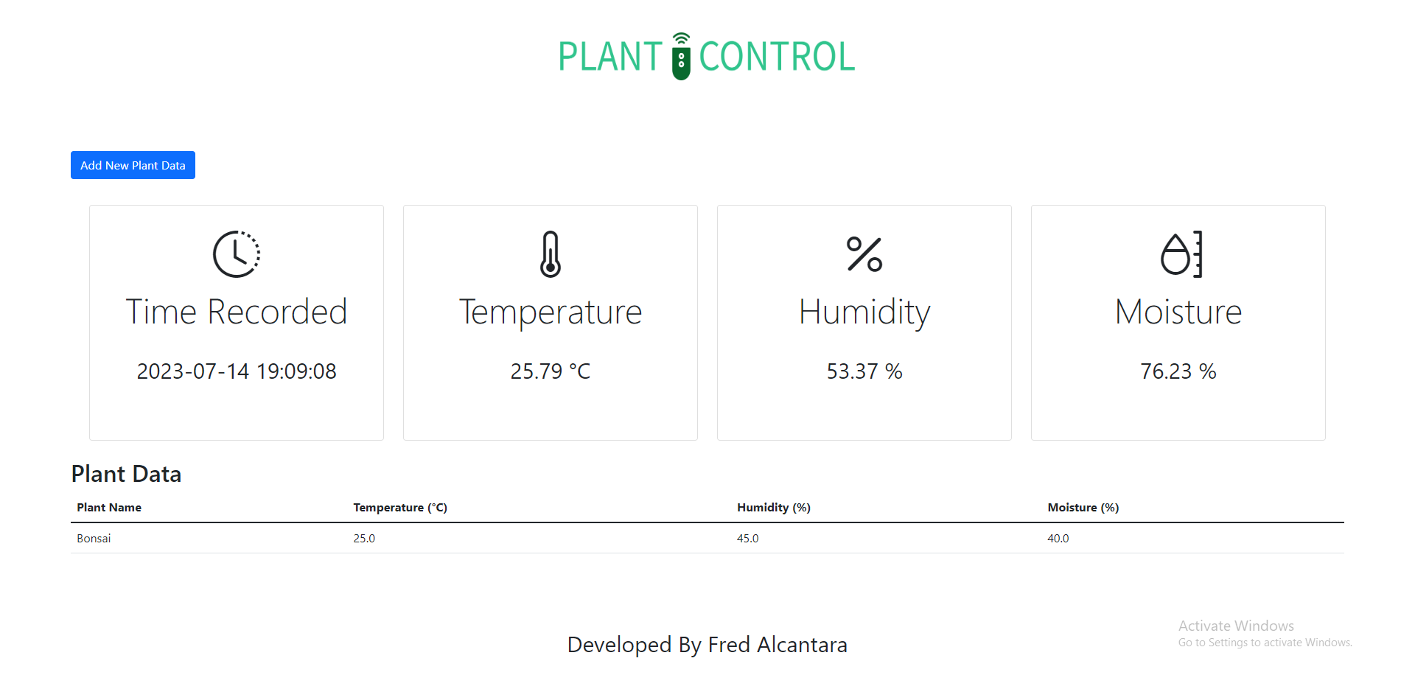
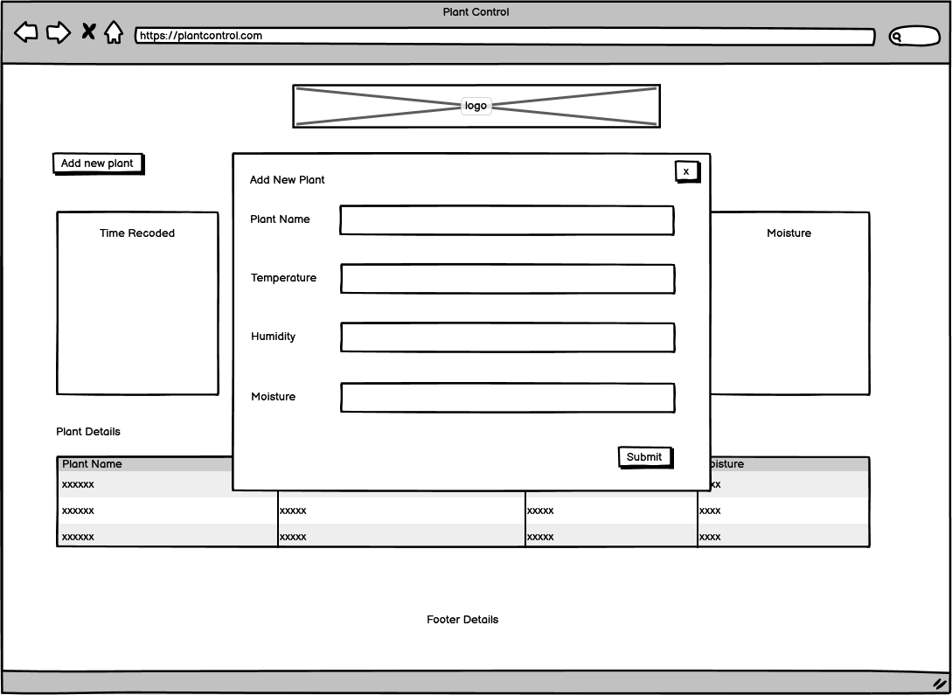
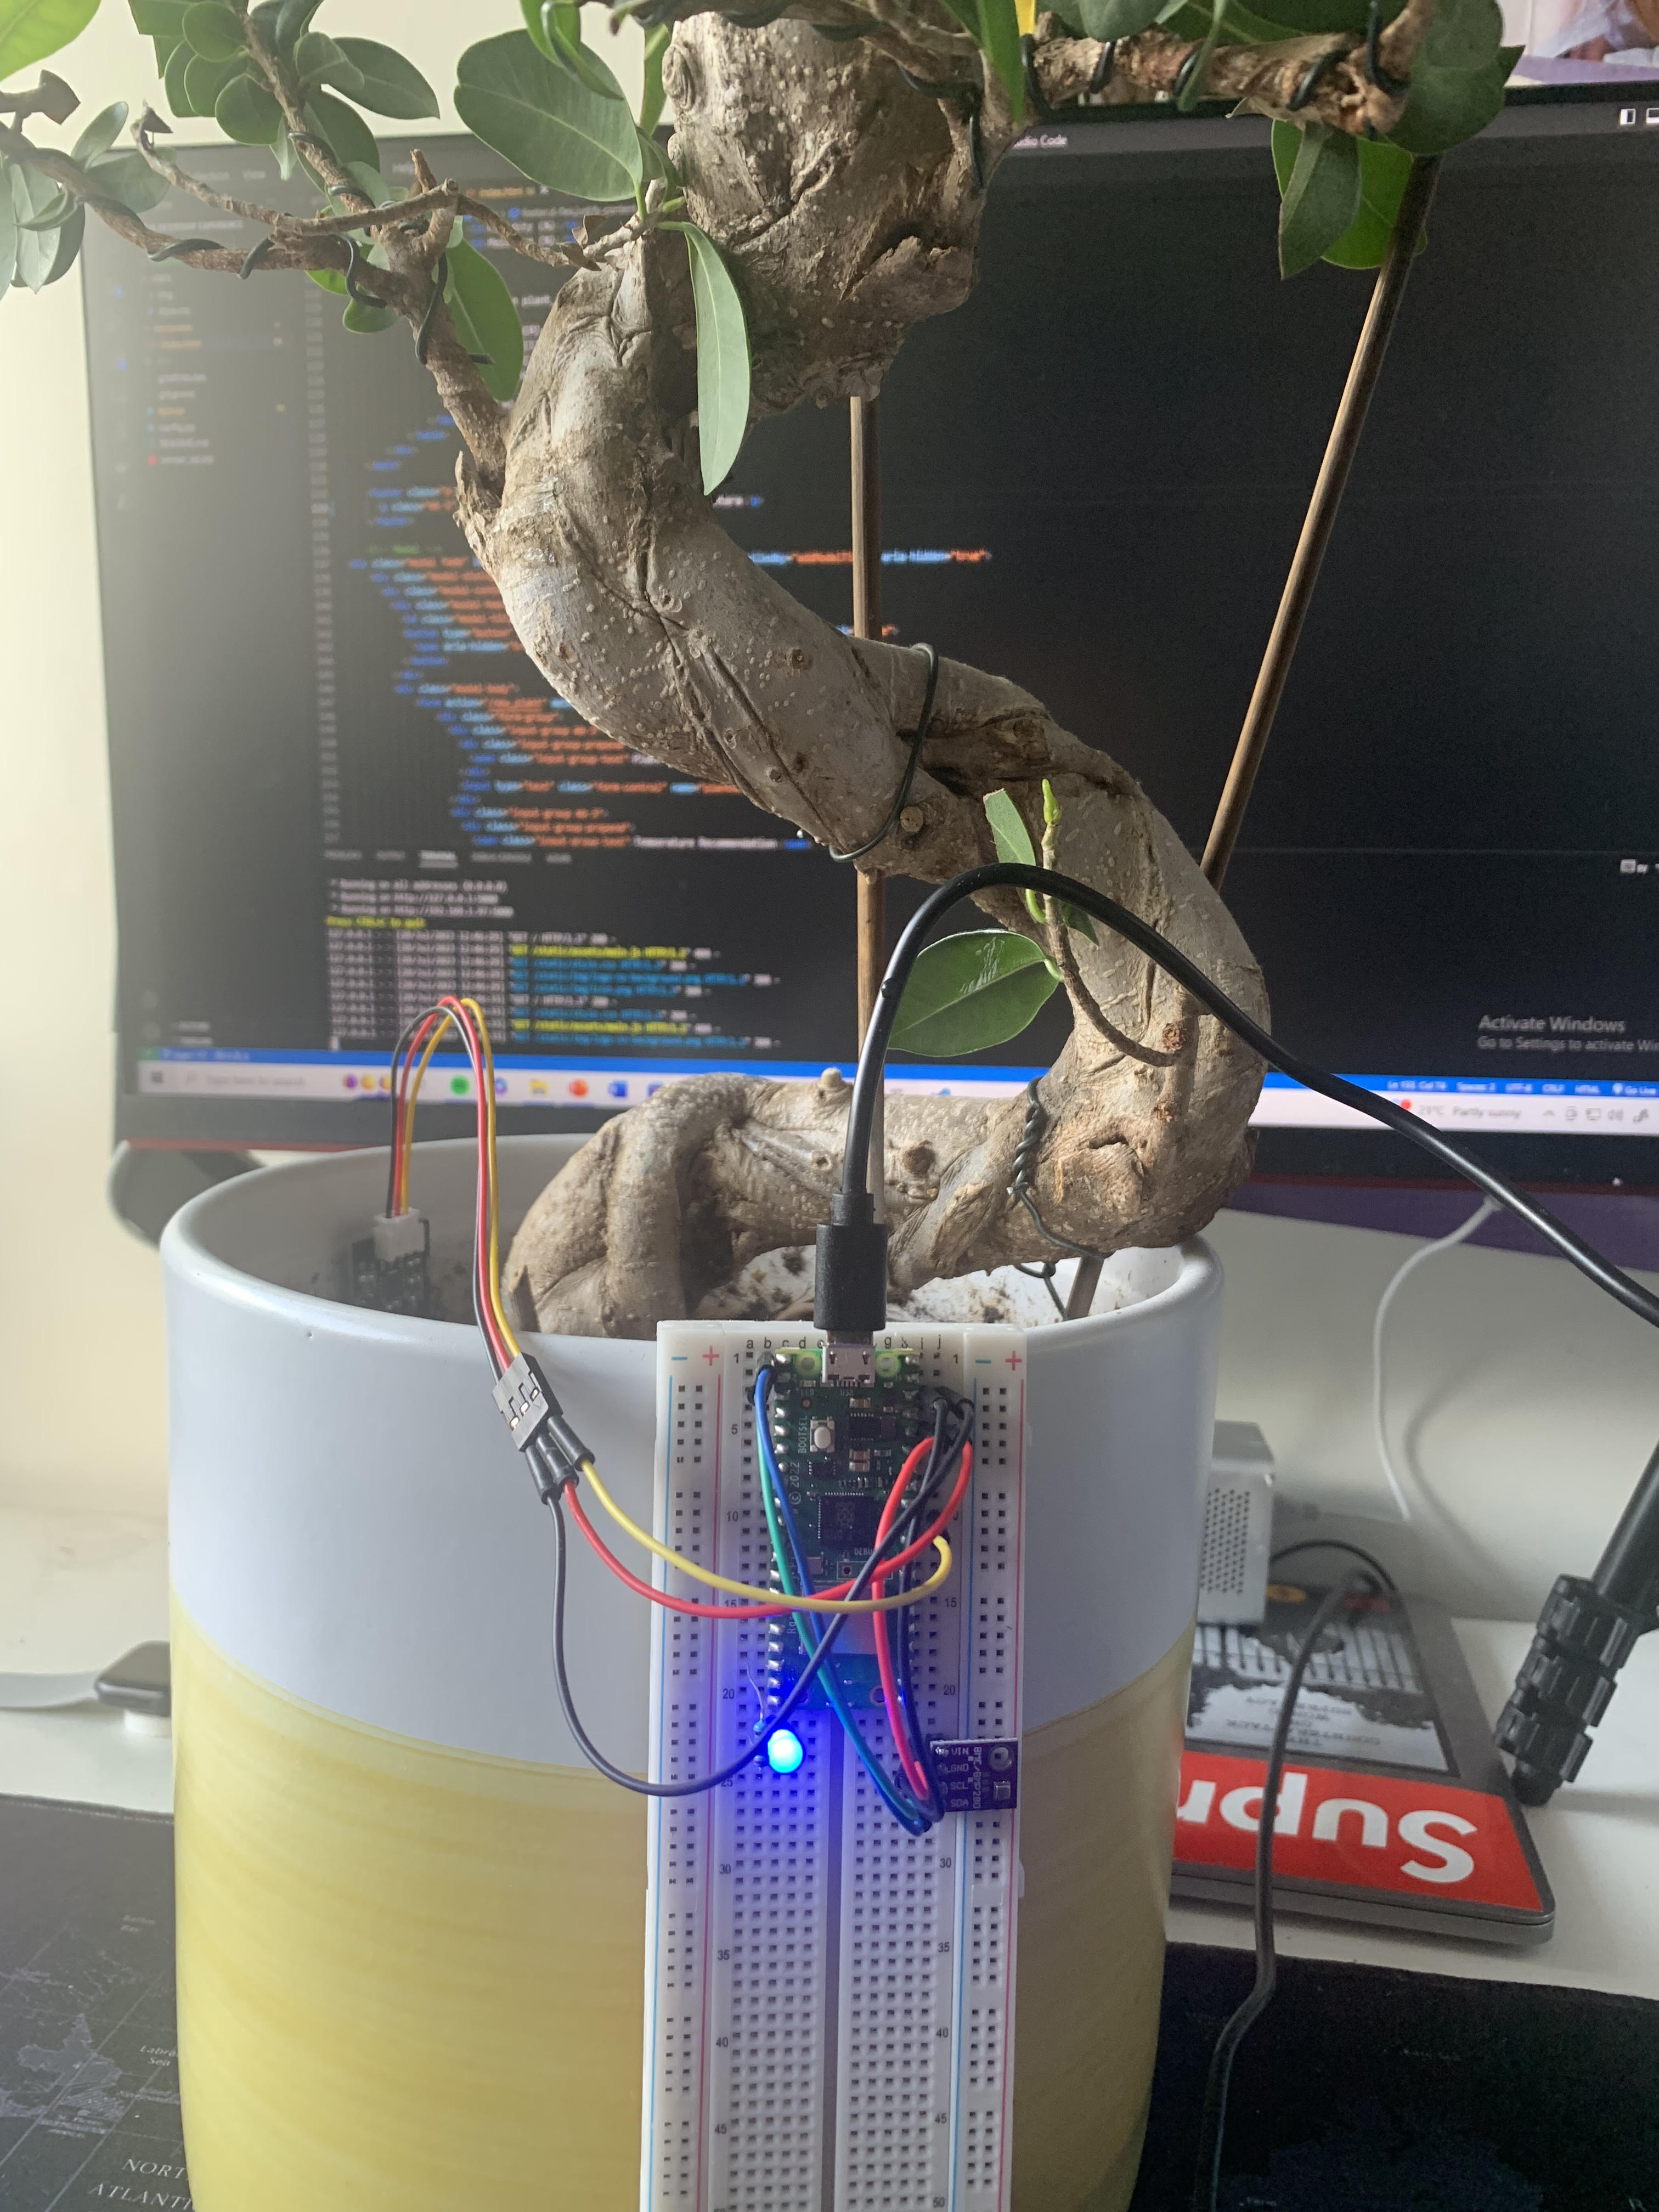
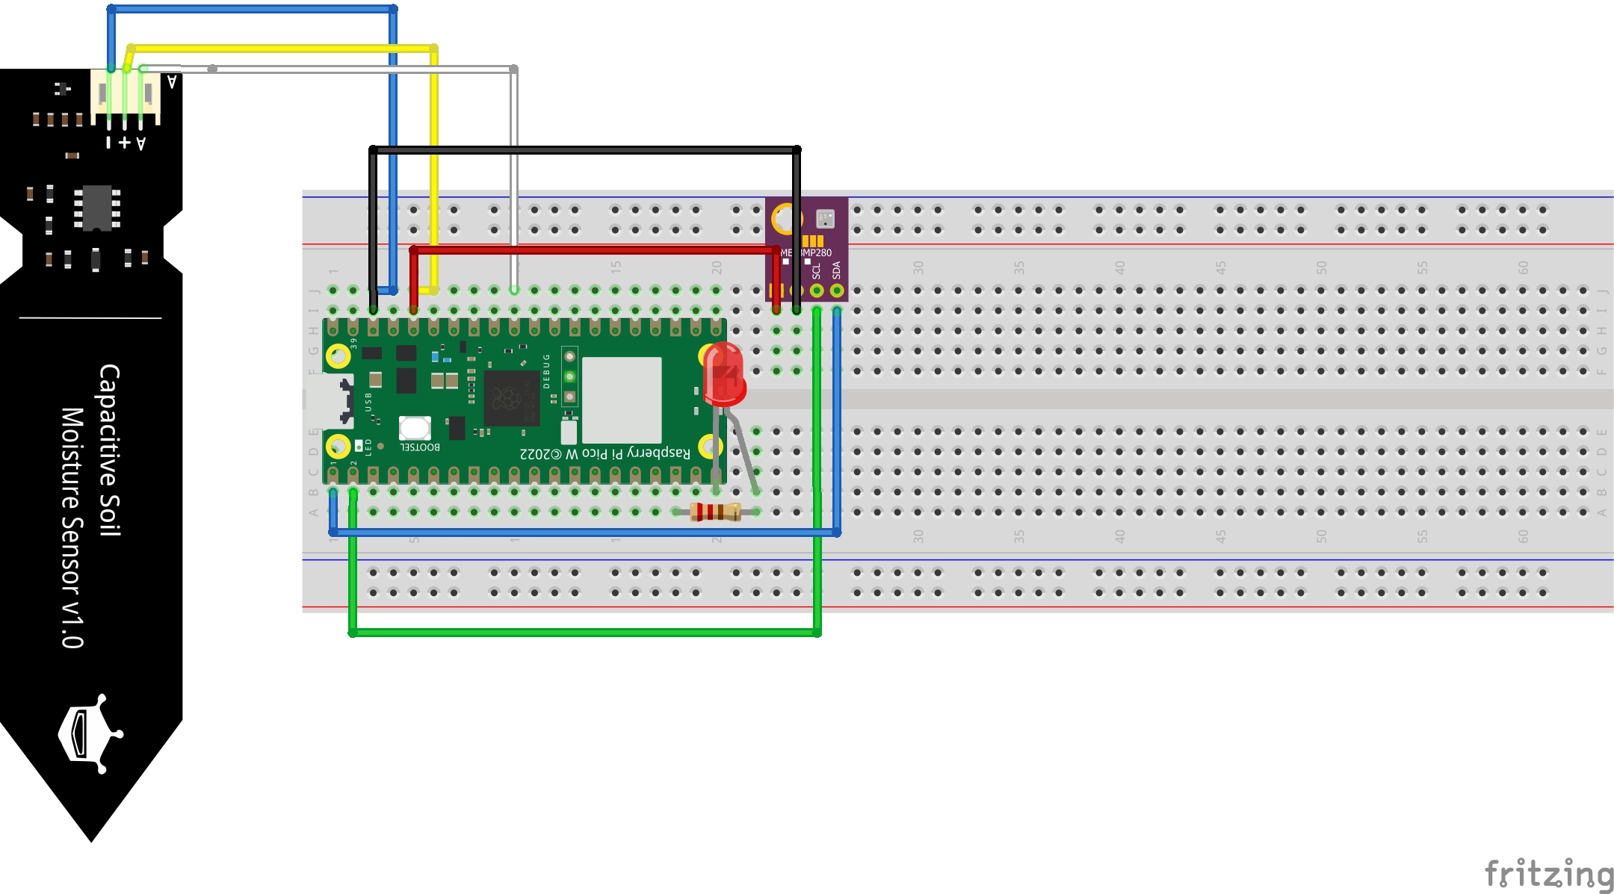
Prototype System
This is the wireframe for a simple prototype system aimed at the chosen business sector. It monitors plant conditions and tracks new plant info. Users can research recommended temperature, humidity, and moisture levels for their plants and keep track of them to grow their desired fruits and vegetables.
Overall, with this system small restaurant owner can successfully grow their own crops for their ingredients, thus, helping support net zero carbon emissions as well as reducing costs for the business.
On the right-hand side is the circuit diagram of the system, accompanied by a photo taken by me showing an initial setup that business owners can use to set up the system.
Technical materials and details can be found in my repository (e.g code files):
https://github.com/FredAlcantara/IEUK-Intership-Experience

